Slide 1
CSC-257 Theory Of Computation (BSc CSIT, TU)
Ganesh Khatri
kh6ganesh@gmail.com

Slide 2




Conversion of Finite Automata to Regular Grammar(RLG)
Rule 1 : if FA has then production will be A → aB
Rule 2 : if FA has then production will be A → aA
Rule 3 : if FA has then, production will be A → aB | a
Rule 4 : if start state is final state i.e. then, add ε in production of start variable S.

Slide 3
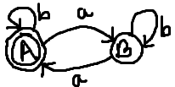
Conversion of Finite Automata to Regular Grammar(RLG)
Example : Convert the following DFA into regular grammar(Right Linear)
Solution :
Regular Grammar is G = ( {A, B}, {a, b, ε}, P, A )
Where P = {
A → aB | bA | b | ε
B → aA | bB | a
}

Slide 4
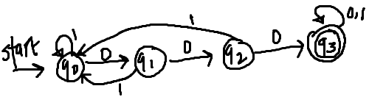
Conversion of Finite Automata to Regular Grammar(RLG)
Exercise : Convert the following finite automata into regular grammar(Right Linear)
1.
2.

